Slide 1
Graphs

Slide 2
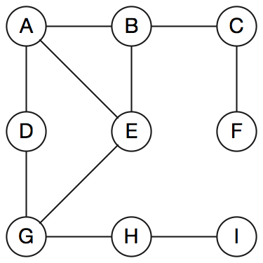
The Graph Data Structure
Represents a relationship between pairs of objects
A graph is a set of objects—vertices—with pairwise connections between them—edges.
It’s not a plot of values on a grid.
An alternative notation: nodes connected by arcs.

Slide 3
Graph Terminology
Two vertices u and v are adjacent if there’s an edge whose endpoints are u and v.
Two adjacent vertices are neighbors; a vertex can have several neighbors.
A path is a sequence of edges.
Path length is the number of edges in the sequence.
Distance is the number of edges in the shortest path.
A is adjacent to E
C – B – A – E is a path of length 3
C's distance from E is 2 (path C – B – E)

Slide 4
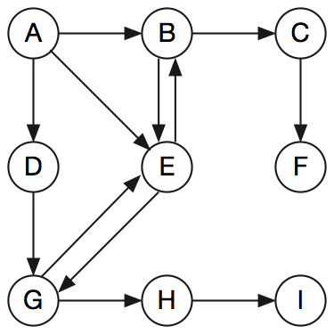
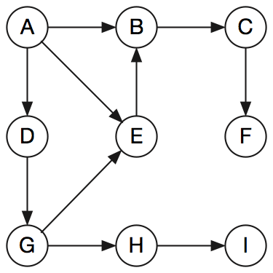
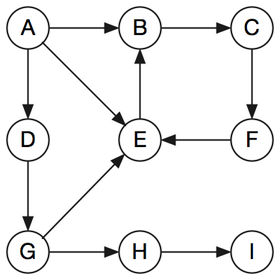
More Terminology
Directed graph: its paths are one-way; vertices can be connected by edge pairs.
Acyclic graph: a directed graph where no path starts and ends at the same vertex
Cyclic graph: a directed graph where some paths start and end at the same vertex
Directed
Acyclic
Cyclic

Slide 5
Examples of Graphs
A city map: intersections and dead ends are vertices; streets are edges
The plumbing or electrical systems in a building: pipes, connectors, and valves; conduits, wires, junctions, switches, and outlets.
An aircraft flight network: airports and airplanes.
The Internet: hosts, cables, and routers.
A project plan and the order of its tasks:
concurrency: some tasks can be done in parallel.
precedence: some tasks must come before others.

Slide 6
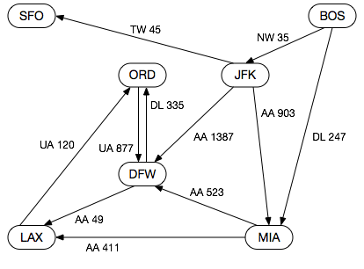
Flight Network.

Slide 7
A Computer Network Example

Slide 8
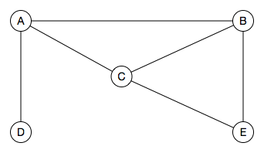
A computer network with five nodes—hosts and routers.
What’s the best path from A to E?

Slide 9

A computer network with the cost of each link.

Slide 10
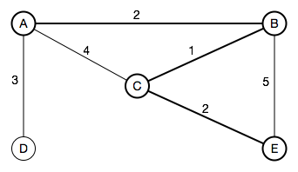
The best path isn’t the shortest one, it’s the fastest one.

Slide 11
A Project Plan Example

Slide 12
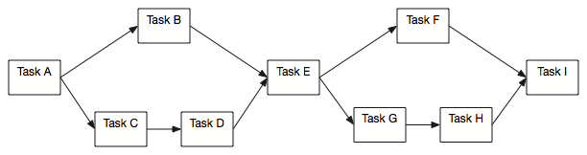
A project precedence network, also known as a Critical Path Chart.
What’s the longest path through the project, which determines how
long the project will take and what the most important tasks are?

Slide 13
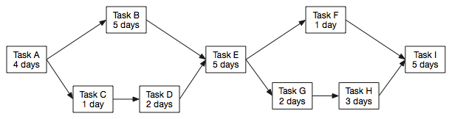
The Critical Path Chart, with the duration of each task shown.

Slide 14
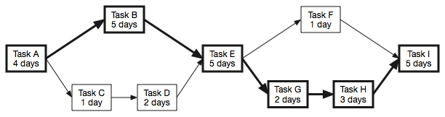
The Critical Path Chart, with the critical path shown. The project will take 24 days, if nothing goes wrong.
Tasks A, B, E, G, H, and I are on the critical path; if any one of them is delayed, the project will finish late. They need careful watching.
Tasks C, D, and F aren’t critical; they can slip without jeopardizing the project. Resources could be diverted to help critical tasks.

Slide 15
Data Structures for Graphs

Slide 16
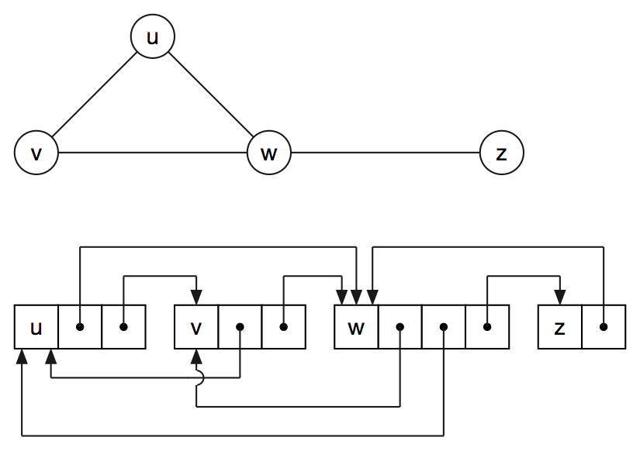
Adjacency List
Compact, usually sparse
Determining adjacency of neighbors can be slow

Slide 17
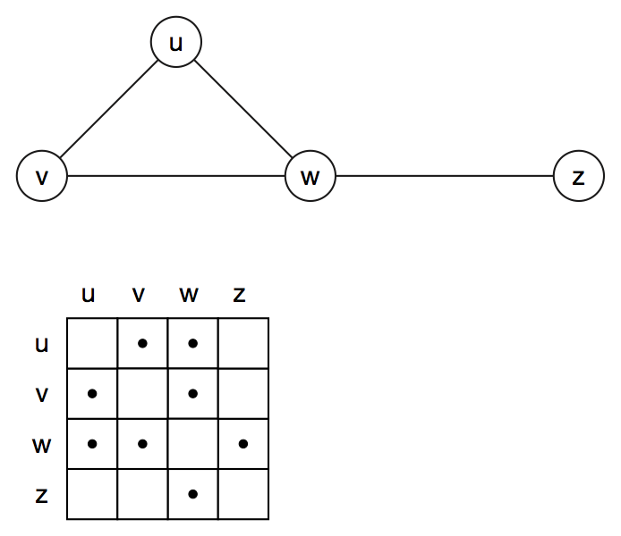
Adjacency Matrix
Quick determination of neighbors
Uses considerable memory

Slide 18
Edge Data
Examples:
Computer network: link costs
Flight network: airline and flight number
Project plan: task names and durations
Adjacency list vertices can point to edge data structs containing:
Edge data
Pointer to neighbor
Adjacency matrix cells can point to edge data structs

Slide 19
Graph Traversals

Slide 20
Depth-First Traversal
For an undirected graph (also works for a directed graph)
Traversing a labyrinth with a string, a paint can, and a brush
Pay out the string as we go; it will let us retrace our steps.
Mark vertices with paint as we visit each one.
A vertex can have several edges leading to adjacent vertices; we’ll visit each one in turn.
We could arrive at a vertex we’ve already visited; the paint mark will show us that and we’ll back up to the previous vertex.
When there are no more adjacent vertices that haven’t been visited, we’ll back up one more vertex (following the string back to where we came from)
As we back up, we’ll look for unvisited adjacent vertices.
Eventually we’ll arrive back at our starting point, having visited every vertex and every edge.

Slide 21
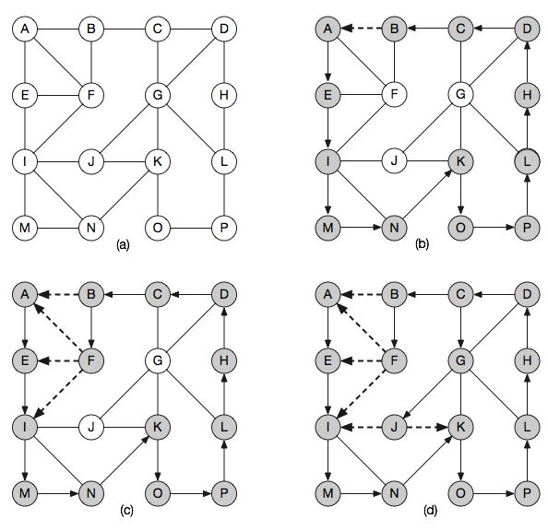
A depth-first search starting at vertex A.

Slide 22
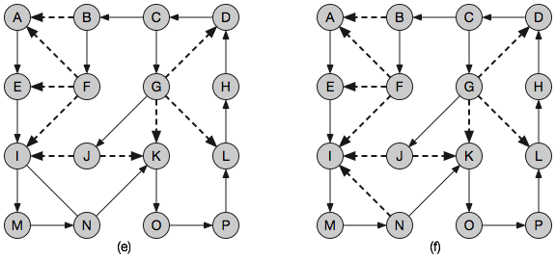
The depth-first search continued.

Slide 23
C++ Implementation

Slide 24
struct Vertex
{ Vertex() : mark_(false) { }
bool mark_;
string name_;
vector<Vertex*> neighborPtr_;
};
class Graph
{
public:
void AddEdge(Vertex* fromPtr, Vertex* toPtr); Vertex* AddVertex(const string& name);
void DepthFirstSearch();
private:
vector<Vertex*> vertexPtr_;
};

Slide 25
void Graph::AddEdge(Vertex* fromPtr, Vertex* toPtr)
{
fromPtr->neighborPtr_.push_back(toPtr);
return;
}
Vertex* Graph::AddVertex(const string& name)
{
Vertex* vertexPtr;
vertexPtr = new Vertex;
vertexPtr->name_ = name;
vertexPtr_.push_back(vertexPtr);
return(vertexPtr);
}

Slide 26
void Graph::DepthFirstSearch()
{
Vertex* neighborPtr;
Vertex* vertexPtr;
stack<Vertex*> vertexStack;
vertexStack.push(vertexPtr_[0]);
while (!vertexStack.empty())
{
vertexPtr = vertexStack.top();
vertexStack.pop();
cout << "Visit " << vertexPtr->name_ << endl;
vertexPtr->mark_ = true;
for (uint64_t i = 0; i < vertexPtr->neighborPtr_.size(); ++i)
{
neighborPtr = vertexPtr->neighborPtr_[i];
if (!neighborPtr->mark_)
{
vertexStack.push(neighborPtr);
}
}
}
return;
}

Slide 27
1 | Push A | A
2 | Pop A | <empty>
3 | Visit A | <empty>
4 | Push B | B
5 | Push E | B, E
6 | Push D | B, E, D
7 | Pop D | B, E
8 | Visit D | B, E
9 | Push G | B, E, G
10 | Pop G | B, E
11 | Visit G | B, E
12 | Push H | B, E, H
13 | Pop H | B, E
14 | Visit H | B, E
15 | Push I | B, E, I
16 | Pop I | B, E
17 | Visit I | B, E
18 | Pop E | B
19 | Visit E | B
20 | Pop B | <empty>
21 | Visit B | <empty>
22 | Push C | C
23 | Pop C | <empty>
24 | Visit C | <empty>
25 | Push F | F
26 | Pop F | <empty>
27 | Visit F | <empty>
28 | Nothing on stack to visit, done

Slide 28
Breadth-First Traversal
Another way to traverse a labyrinth with a string, a paint can, and a brush.
Pay out the string in levels, each one the length of an edge.
Visit the vertices that are one level away before going any deeper.
Then go forward another level, rolling out one more edge length of string, deeper into the graph.
Edges that connect to new unvisited vertices are called discovery edges—the heavy arrows in the diagrams that follow.
Edges that connect to previously visited vertices are called cross edges—the dashed arrows in the diagrams that follow.

Slide 29
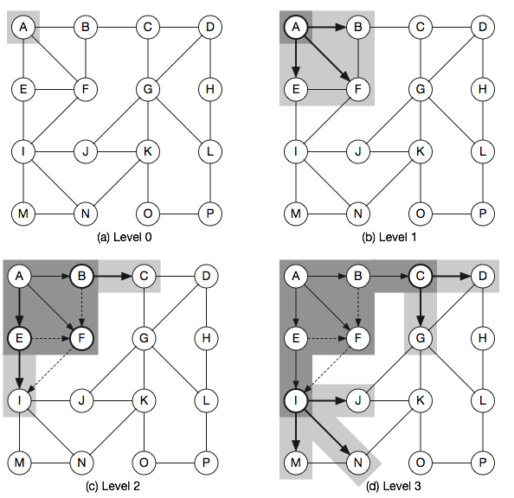
Breadth-first traversal

Slide 30
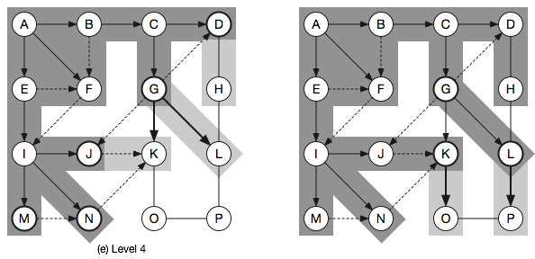
Breadth-first traversal, continued.

Slide 31
void Graph::BreadthFirstSearch()
{
Vertex* neighborPtr;
Vertex* vertexPtr;
queue<Vertex*> vertexQueue;
vertexStack.push(vertexPtr_[0]);
while (!vertexQueue.empty())
{
vertexPtr = vertexQueue.front();
vertexQueue.pop();
if (vertexPtr->mark_)
{
cout << "Visit " << vertexPtr->name_ << endl;
vertexPtr->mark_ = true;
for (uint64_t i = 0; i < vertexPtr->neighborPtr_.size(); ++i)
{
neighborPtr = vertexPtr->neighborPtr_[i];
if (!neighborPtr->mark_)
{
vertexQueue.push(neighborPtr);
}
}
}
}
}

Slide 32
1 | Push A | A
2 | Pop A | <empty>
3 | Visit A | <empty>
4 | Push B | B
5 | Push E | B, E
6 | Push D | B, E, D
7 | Pop B | E, D
8 | Visit B | E, D
9 | Push C | E, D, C
10 | Push E | E, D, C, E
11 | Pop E | D, C, E
12 | Visit E | D, C, E
13 | Push G | D, C, E, G
14 | Pop D | C, E, G
15 | Visit D | C, E, G
16 | Push G | C, E, G, G
17 | Pop C | E, G, G
18 | Visit C | E, G, G
19 | Push F | E, G, G, F
20 | Pop E (ignore) | G, G, F
21 | Pop G | G, F
22 | Visit G | G, F
23 | Push H | G, F, H
24 | Pop G (ignore) | F, H
25 | Pop F | H
26 | Visit F | H
27 | Pop H | <empty>
28 | Visit H | <empty>
29 | Push I | I
30 | Pop I | <empty>
31 | Visit I | <empty>
32 | Nothing in queue to visit, done

Slide 33
Dijkstra’s Algorithm: A Breadth-First Traversal
Used to find the shortest paths through a graph—the basis of two Internet routing algorithms.
The graph’s edges are labeled with the “cost” of taking that path.
Build a “shortest path” graph, where each vertex is labeled with the cost of reaching that vertex from a given starting vertex.
The initial graph has only the starting vertex with a cost label of 0.
The graph is extended by adding neighbors, labeling them with costs, and advancing the search from the lowest cost node, which may be a previously added node, not a newly added neighbor.
The example algorithm labels vertices but doesn’t track paths. That function was left out to focus on the traversal itself.

Slide 34
Repeat the following steps of the algorithm:
Choose the unvisited vertex with the lowest cost label and mark it “visited”. In the diagrams that follow, by shading in its circle.
Add the newly-added vertex’s neighbors to the graph. Some neighbors may already be in the graph because they are neighbors of another previously-added vertex ; if so, just add edges to those vertices.
Label each neighbor with the cost of the edge from that starting vertex. Some neighbors, the ones that were already in the graph, will have labels. If the new cost is lower, replace the label; otherwise, leave the label alone.
Add that vertex’s neighbors to the graph.
Repeat steps 1–4 until all vertices have been visited.
Note: On the first pass through the loop, the vertex chosen will be the starting vertex—it’s the only one in the graph. On subsequent passes, the chosen vertex can be any unvisited vertex, which is not necessarily one that was just added to the graph. It could be from a previous pass over the graph.

Slide 35
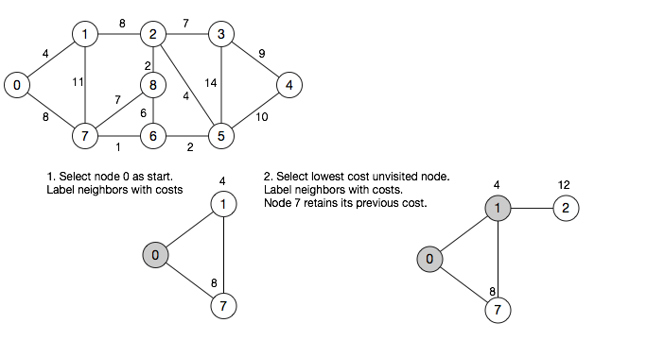

Slide 36
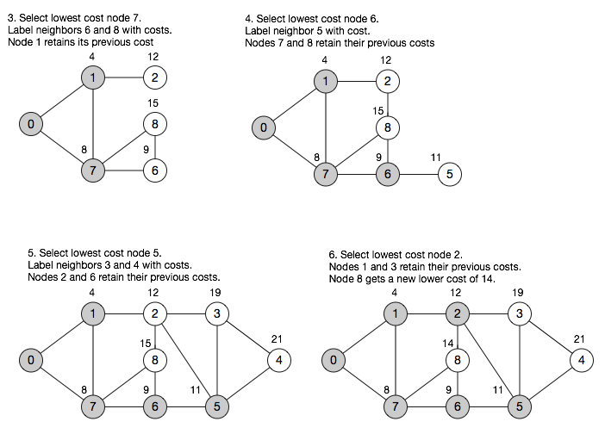

Slide 37
